Slide 1
ASPEN Nutrition Science & Practice Conference
Presentation Template
INSTRUCTIONS: Please use this template for your conference presentation.
The slides labeled REQUIRED are necessary to ensure that ASPEN remains in compliance with various accrediting bodies. All other slides are for samples or informational purposes.
The ASPEN logo should be included on your slides.
The yellow boxes on slides contain instructional text only. Please review this information before completing your presentation.
Please delete the yellow boxes with instructional text and any unused template slides before submitting your final presentation!

Slide 2
Presentation Title
Presentation Title Slide – With Photo
To insert photo within picture box, 1) click on the box, 2) select the appropriate photo from your computer, 3) click on Insert.
If photo is cropped and does not fit within picture box, do the following:
After inserting photo, you should see the Picture Format menu on the top right screen. Underneath this menu, select the downward facing arrow under Crop on the far-right side of screen.
Scroll down to bottom of menu and click on Fill, then use your mouse to move the photo so that it fits within the box.
Name, Credentials
Professional Title
Department
Organization
City, state

Slide 3
Presentation Title
Presentation Title Slide – No Photo
If you are not including your photo, use this slide for your presentation title page.
Name, Credentials
Professional Title
Department
Organization, City, State

Slide 4
Section Title
Section Divider Slide
Use this slide to separate different topics or sections in your presentation.

Slide 5
Disclosures
Disclosures Slide - Required
In order to comply with accreditation guidelines, disclose ALL financial relationships with ineligible companies within the past 24 months. Enter Name of Company and Affiliation. If you do not have any disclosures, enter “No commercial relationships to disclose.”
Examples:
No commercial relationships to disclose
Name of Company, Affiliation
Acme Company, Speaker’s Bureau
Delta Company, Researcher
Notes:
Read the Slide

Slide 6
Learning Objectives
Learning Objectives Slide - Required
Please add at least 3 learning objectives for your presentation. For assistance with writing learning objectives, right click on Faculty Information, select Open Link, and then go to the Developing Learning Objectives section.
Upon completion of this educational activity, the learner will be able to:
Objective one
Objective two
Objective three

Slide 7
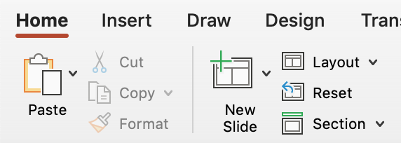
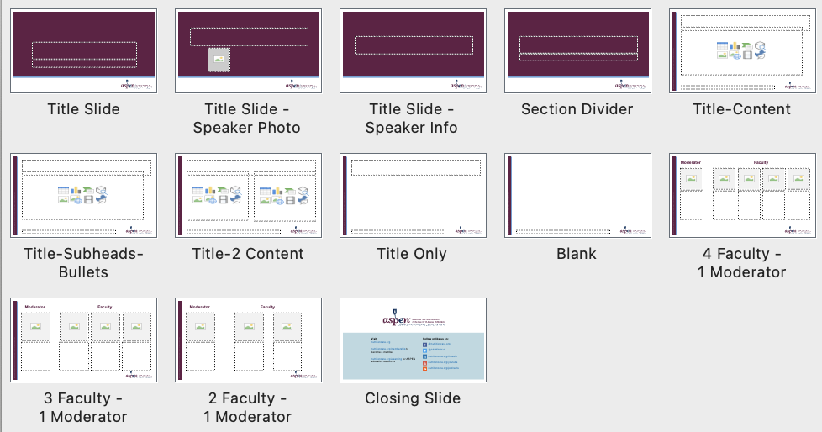
Slide Layouts
How to change the slide layout.
How to access layouts
All layouts are labeled and available in the layout panel of the toolbar
How to use layouts to format
Option 1: “New Slide” in the toolbar will add a new slide and assign it the previously selected layout. To update the layout, go to the layout panel and choose another option.
Option 2: “Copy & Paste” any slide in this template and customize as needed.

Slide 8
Sample Slide
References should be listed at the bottom of the slide and included in the final references slide at the end of this deck.
If the same reference is used on consecutive slides, it should be repeated at the bottom of each slide.
All images must be cited, even if they are screen grabs/taken from the internet.
Follow the AMA style, abbreviating names of journals according to Index Medicus.
Bullet point one
Sub bullet point
Bullet point two
Sub bullet point
Sub bullet point
Bullet point three
Sub bullet point
Please put references on the bottom of the slide and compile them into the final references slide.
Follow the AMA style, abbreviating names of journals according to Index Medicus.

Slide 9
Sample Slide
Sample slides demonstrate ideas for including content in your presentation (case studies, charts, graphs, tables, etc.).
This information is not required but can be visually stimulating for the audience.
Was trialed on a Gastrostomy-Jejunostomy and tube feedings along with Parenteral Nutrition (PN) in the past (developed cholestatic liver disease).
Never gained weight on tube feeds. Weight went from 190 to as low as 76 pounds.
Patient was getting by, just eating orally and maintaining weight around 103 pounds, until February of 2020.
Please put references on the bottom of the slide and compile them into the final references slide.
Follow the AMA style, abbreviating names of journals according to Index Medicus.

Slide 10
Sample Slide
Sample slides demonstrate ideas for including content in your presentation (case studies, charts, graphs, tables, etc.).
This information is not required but can be visually stimulating for the audience.
HPI:
Profuse diarrhea + abdominal pain
Current medications: cyclosporine, prednisolone
Findings:
↑ cyclosporine level
labs consistent with AKI and dehydration
PMH:
Diffuse anaplastic Wilms Tumor w/ pulmonary metastatic disease
Treatment-related Myelodysplastic Syndrome
Day +55 s/p HSCT
Post-HSCT course notable for GI GVHD
Please put references on the bottom of the slide and compile them into the final references slide.
Follow the AMA style, abbreviating names of journals according to Index Medicus.

Slide 11
Sample Slide
Sample slides demonstrate ideas for including content in your presentation (case studies, charts, graphs, tables, etc.).
This information is not required but can be visually stimulating for the audience.
xx
x
xx
xx
Please put references on the bottom of the slide and compile them into the final references slide.
Follow the AMA style, abbreviating names of journals according to Index Medicus.

Slide 12
Sample Slide
Sample slides demonstrate ideas for including content in your presentation (case studies, charts, graphs, tables, etc.).
This information is not required but can be visually stimulating for the audience.
xx | xx | xx
Intact protein is more trophic | Long-chain triglycerides stimulate adaptation | Disaccharides may be poorly absorbed due to loss of brush border enzymes
Amino-acid based reduces risk of secondary protein intolerance | Medium-chain triglycerides may be better absorbed (independent of bile salts) | Soluble fiber promotes adaptation and can be added when colon is present
Please put references on the bottom of the slide and compile them into the final references slide.
Follow the AMA style, abbreviating names of journals according to Index Medicus.

Slide 13
Sample Slide
Sample slides demonstrate ideas for including content in your presentation (case studies, charts, graphs, tables, etc.).
This information is not required but can be visually stimulating for the audience.
xx | xx | xx
High losses after bowel resection, along with Mg + Se Deficiency can present with dermatitis Co-factor for ALP synthesis so ALP levels are low in deficiency | Both have been implicated in IFALD Copper deficiency = pancytopenia Monitor levels | Consider deficiency for patients receiving mostly parenteral nutrition Can usually be replaced enterally due to absorption in the duodenum
xx | xx
In preterms check 25-OH-D after 2 weeks on PN In infants and children check levels every 3-4 months | Patients who have lost significant ileum at high risk for deficiency Monitor levels every 4-6 months
Please put references on the bottom of the slide and compile them into the final references slide.
Follow the AMA style, abbreviating names of journals according to Index Medicus.

Slide 14
Sample Slide
Sample slides demonstrate ideas for including content in your presentation (case studies, charts, graphs, tables, etc.).
This information is not required but can be visually stimulating for the audience.
XXX | XXX | XX | XX | XX | XX
06/09/2020 | 134 L | 3.4 L | 8.6 | 4.1 | 2.3
06/10/2020 | 136 | 3.3L | 7.8 L | 3.3 L | 2.6
06/11/2020 | 138 | 4.2 | 8.1 L | 3.1 L | 2.6
06/13/2020 | 136 | 4.4 | 8.9 | 3.8 | 3.8 H
Please put references on the bottom of the slide and compile them into the final references slide.
Follow the AMA style, abbreviating names of journals according to Index Medicus.

Slide 15
Learning Assessment Question
Learning Assessment Question Slide(s) - Required
Include three to five (3 to 5) learning assessment questions in your presentation. You can use the same questions from your outline.
Questions should contain at least four answer choices. Answers choices should not include “all of the above,” “none of the above,” or “true/false.”
For assistance with writing learning assessment questions, right click on Faculty Information, select Open Link, and then go to the Developing Learning Assessment Questions section.
Multiple choice question 1?
Option 1
Option 2
Option 3
Option 4

Slide 16
Learning Assessment Answer
Learning Assessment Answer Slide(s) - Required
Highlight correct answer in bold/pink. Change letter to pink in the bullets/numbering dropdown.
Multiple choice question 1?
Option 1
Option 2
Option 3
Option 4

Slide 17
References List
References Slide(s) – Required
List references used in your presentation on this slide and include at the end of your presentation.
Follow the AMA style, abbreviating names of journals according to Index Medicus. For 1-6 authors, list each author. For 7 or more authors, list the first 6 authors, followed by et al.
AuthorLastname, FirstInitialMiddleInitial. Title in sentence case. Abbreviated Journal Title in Title Case. Year Month Day; volume(Issue#): PP-PP.
Kelly DG. The clinician’s Responsibility for the Consumer’s Financial Well-Being. Nutr Clin Pract. 2006: 21(6) 539-541.
Majka A, Wang Z, Schmitz K. Care Coordination to Enhance Management of Long-Term Enteral Tube Feeding: A Systematic Review and Meta-Analysis. JPEN J Parenter Enteral Nutr 2014;38 40-52
Matarese LE, Costa G, Bond G, et al. Therapeutic efficacy of intestinal and multivisceral transplantation: survival and nutrition outcome. Nutr Clin Pract. 2007;22 474-481.
The ASPEN Adult Nutrition Support Core Curriculum, 3rd ed., Silver Spring MD ASPEN, 2017.

